Slide 1
Enhancing international roaming performance : NAPTR Records in DNS
Dr Alan Buxey
#nws41

Slide 2
Introduction
How packets go through eduroam
A solution to reduce the bottleneck/load
The result
Explanation/How It Works
Issues
Future extensions
Summary
Questions/feedback

Slide 3
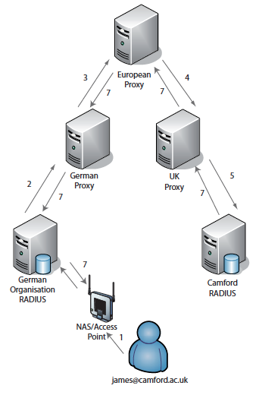
Hierarchical architecture of eduroam
James using eduroam in some German City
‘magic’ happens and he is online
RADIUS packets routed by fixed lists
at the top (european proxy)
Lots of hops. Inefficient.
.net, .org, .edu etc all cause problems

Slide 4
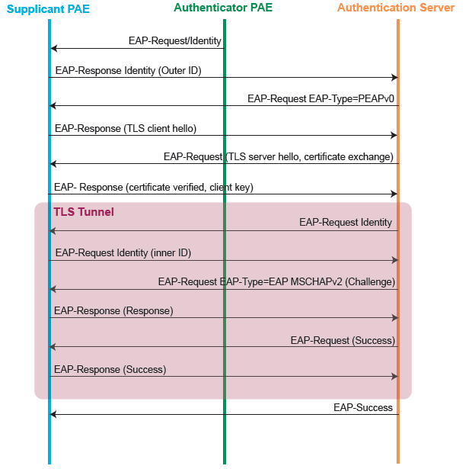
..a lot of conversation!
All of this goes on across the
Proxy path!
UDP too, so chances of issues

Slide 5
The “quick-win” fix? Dynamic Discovery
Dynamic Discovery of relevant national proxy
Places routing hints towards the responsible national proxy into DNS, making routing more efficient
eduroam say: “As an IdP, you do not have to know much about the mechanics behind this”
…..but we beg to differ in opinion ;-)

Slide 6
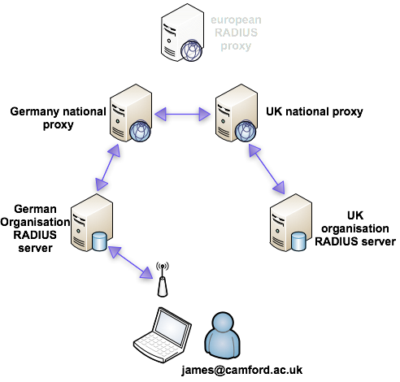
Dynamic discovery at the National level
Request goes up to National level
The national proxy does a lookup
camford.ac.uk is via UK
Sent to UK using RADSEC
Everything else as before…just
a fewer hops (and often much
shorter distance!)

Slide 7
How did it know to send to the UK?
DNS query for a NAPTR record (based on realm)
Network Authority PoinTeR – resource record type
Not in common use (used a lot with SIP!)
Powerful options…but eduroam implementation is ‘simple’, as follows

Slide 8
NAPTR definition
camford.ac.uk. 43200 IN NAPTR 100 10 "s" "x-eduroam:radius.tls" "" _radsec._tcp.roaming.ja.net.
camford.ac.uk – zone name/label for which the NAPTR entry is defined
43200 – DNS lifetime for the entry (in seconds) as per other records
IN – This entry is for Internet consumption – like other records
NAPTR – This entry is a Network Authority Pointer
100 – Order number, lower prefered…only have one entry anyway!)
10 – Priority, if multiple with same order, highest first (only have one entry anyway!)
“s” – do a DNS query for a SRV record after getting the value. Any other entry (e.g. u or a) is invalid!
"x-eduroam:radius.tls" – The service. Only use if you want to use this service, basically means eduroam using RADIUS with TLS – it’s a fixed value.
“” – REGEX support. Very powerful, used in SIP, we don’t use it in eduroam
_radsec._tcp.roaming.ja.net – target. If you want to use the x-eduroam service, get the SRV records, resolve the hostname and the ports to use

Slide 9
The SRV part (demonstrated)
# dig -t SRV _radsec._tcp.roaming.ja.net
; <<>> DiG 9.8.2rc1-RedHat-9.8.2-0.17.rc1.el6_4.4 <<>> -t SRV _radsec._tcp.roaming.ja.net
;; global options: +cmd
;; Got answer:
;; ->>HEADER<<- opcode: QUERY, status: NOERROR, id: 46221
;; flags: qr rd ra; QUERY: 1, ANSWER: 3, AUTHORITY: 4, ADDITIONAL: 7
;; QUESTION SECTION:
;_radsec._tcp.roaming.ja.net. IN SRV
;; ANSWER SECTION:
_radsec._tcp.roaming.ja.net. 50382 IN SRV 0 0 2083 roaming2.ja.net.
_radsec._tcp.roaming.ja.net. 50382 IN SRV 0 0 2083 roaming0.ja.net.
_radsec._tcp.roaming.ja.net. 50382 IN SRV 0 0 2083 roaming1.ja.net.
So port 2083 on those 3 servers for camford.ac.uk

Slide 10
Issues?
Makes the path less ‘predictable’ – packets not simply to ‘end hosts or european proxy’
Packets may go to different servers based on DNS – what happened at 14:00?
Microsoft 2008 or earlier? No NAPTR for you ☹
(Google “NAPTR record windows 2008 DNS” and Janet community NAPTR page is the top hit ☺ )

Slide 11
Future?
Do NAPTR checks at the organisation level – no National Proxies
eduroam service site does query
Home/ID site replied with its own values
Software maturity required (many RADIUS servers wont support this for years..if at all)
Technical specification/policies changed (all requests must go via national proxy for remote sites)
Logging/stats submissions e.g. F-TICKS

Slide 12
Summary
How packets go through eduroam (hierarchy)
A solution to reduce the bottleneck/load (DS)
The result (shorter path/distance)
Explanation/How It Works (NAPTR records)
Issues (troubleshooting, DNS that doesn’t do it)
Future extensions (further RADSEC/DS deployment)

Slide 13
One small step for admins, one giant leap for RADIUS packets
Questions? Feedback?
Notes:
1966 group. NOT the modern ‘The Thrills’

